Slide 1
Sales
Dynamics NAV
Copyright Microsoft, Modified by Instructor

Slide 2
New Customer
General
  Paint Outlet
  10 JFK Blvd, Boston; Contact – Cecil Rhodes
Invoicing
  Gen. Bus. Posting Group → ? (select appropriate)
  Customer Posting Group → ?
Payment
  Manual
  Terms:7 Days

Slide 3
Sales Quote
Paint Outlet has requested quote for 10 Cans of ‘UMB’
  Open New Sale Quote
  Select Customer
  Notice the ‘Document Date’ and ‘Due Date’
  Add “UMB” Item in ‘Lines’ section
  Location – Green; Qty on Hand???
  Change Location – Blue
  Qty – 10; OK.

Slide 4
Sales Order
Open the sales quote
  Turn it to Sales Order (‘Make Order’ in ‘Home’ Ribbon
What happens to sales quote?
Next – Post the sales order (meaning?)
  We ship and Invoice the order
Notice the invoice
  On navigation Pane – Posted Documents– Posted Sales Invoices

Slide 5
Posted Sales Invoice
What happens to customer entries?
Let us see Customer Ledger Entries
  Open the ‘Paint Outlet’ customer.
  Select ‘Ledger Entries’ from Home Ribbon
  You should see the customer invoice
What happens to Items?

Slide 6
Item Contd.
How is this going to effect Items?
  Select Item ‘UMB’
  Open the item card – Notice the Qty on Hand
  On ‘Home’ Ribbon – select ‘Ledger Entries’
    What do you see? – Item Ledger Entries
    You have the ability to select the entries and use ‘Navigate’ to see related records

Slide 7
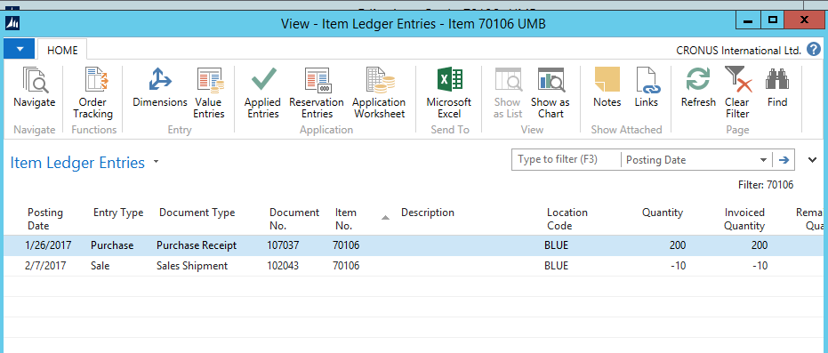

Slide 8
Post the payment
Payment is received
  We are going to apply the customer payment to their account
Search for ‘Cash Receipt Journals’ in NAV
Open the ‘Bank’ Account
Posting date – choose past customer order date
Document type – payment
A/c Type – customer
A/C No – choose ‘paint outlet’
Applies to doc – Invoice
Applies to doc no
  This should open up all outstanding amounts from the selected customer. Choose the right invoice (you should only have one invoice, unless you processed many orders)
‘Post’ the line. Important step!

Slide 9
Crosscheck the received payment
Select Customer
Check Balance (should be zero)
  Find Customer Ledger Entries – it should show details of the transaction
  Can again use ‘Navigate’ to see related documents

Slide 10
